Slide 1
Nix - a space odyssey
NixCon 2022
Notes:
Start with a “welcome and thank you”
I’m Leandro
This is “Nix - a space odyssey”
We’ll see the story of how Nix (& NixOS) help manage (transition to next slide) our satellite payload

Slide 2
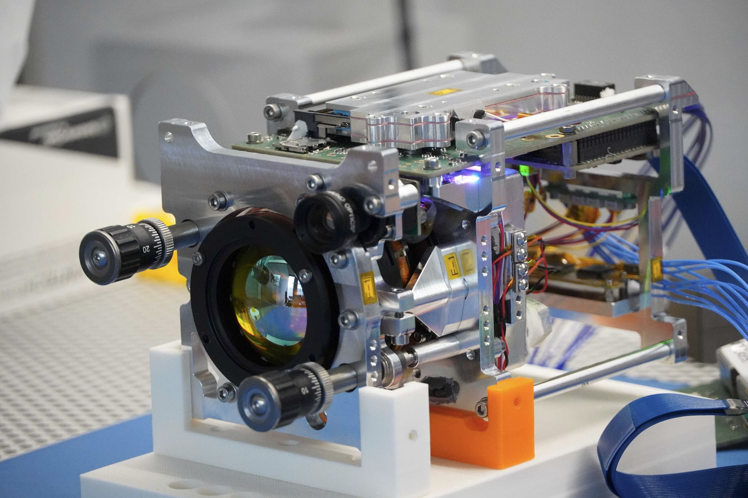

The context
OroraTech
  Wildfire detection and monitoring services
  Design and deploy own
  satellite payloads
Top picture taken by Spire
Bottom image from our FOREST-1 payload
Notes:
Putting things into context
This is all from the POV of satellite payload development
We have not just our own software but also custom hardware that requires its own kernel modules
Allows us to take pictures, such as (change slide) these

Slide 3
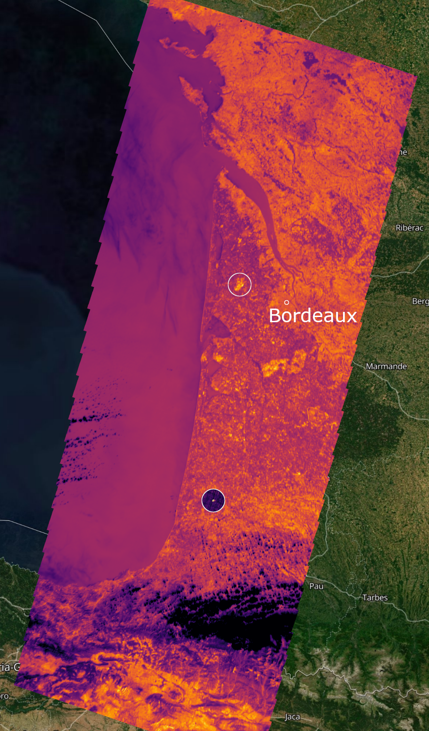

The context
Images from our FOREST-1 payload
Notes:
Some examples of pictures taken from our FOREST-1 payload
Left is a failed attempt from me to get a picture of Paris these last few, very cloudy, days
Right is an older image from Bordeaux, overlaid over a map for reference
But, this is the state of the project about a year ago, when FOREST-1 was deployed. It is after this I come in (next slide)

Slide 4
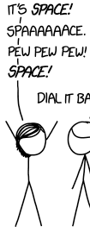
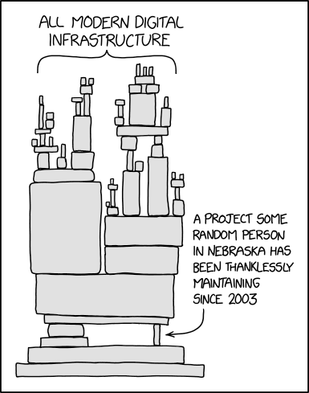
The problem
Be me
Happy to get hired as Embedded Linux engineer
Arrive to a massive undocumented Makefile debootstrap mess
Software updates on the satellite are completely manual
* cries in spanish *
Super awesome satellite payload design
An NVidia Jetson running a haphazardly put together Debian image
new hire me
Left picture based on XKCD 2124 - Space mission hearing
Right picture based on XKCD 2347 - Dependency
(CC BY-NC 2.5)
Notes:
State about a year ago:
Just about to launch first payload as a PoC
System is based on an NVidia Jetson
Rushed architecture designs and software implementations
Stick to simple Debian image with hacky-ish customisation
Update by sending files and running commands manually
Slow and hard process due to limited throughput
For the following payload deployment these problems had to be resolved, so (next slide) a vague plan started to form

Slide 5






The plan
All icons freely available from uxwing
Left picture from XKCD 1375 - Astronaut vandalism (CC BY-NC 2.5)
Notes:
This plan roughly consisted of:
Having developers work on their own personal machines (instead of having to SSH into a shared ARM, rsync-ing / git checkout the source, and then build)
Some semi-automated pipeline is then used to build & deploy OS and software updates (in place of the fully manual process)
First deploying to ground replica of the satellite for automated and manual testing (hence the semi part in semi-automated pipeline)
Finally, once things look good, deploy to real satellite (again, manually triggered process)
And so (move to next slide) this is how nix comes into the picture

Slide 6

The idea
Use Debian and manually update everything, and eventually irreversibly fuck up the entire thing
Use Debian + nix to build, test, and update the software more reliably, plus provide a rollback path
Use NixOS to not only manage software but also the configuration of the system
Use NixOS flakes to have a fully reproducible OS that we can thoroughly test on ground
Notes:
Now, the idea quickly lead us down a deep rabbit hole of possibilities provided by Nix
Keep the base Debian image but slap Nix on top
But why not go the extra mile and use NixOS directly
And while at it, why not try out these “flakes” that I’ve heard so much about (and promptly fall in love with them)
And so, with this in mind we went to the drawing board and started working on (next slide) the design

Slide 7







The design
NVidia logo property of NVidia
Nix snowflake owned by NixOS Foundation (CC BY 4.0)
All other icons freely available from uxwing
Notes:
(Rapid-ish succession of slides to follow, since I could not get animations to easily recreate what I wanted)
Since manual software & hardware testing is a hard requirement, everything centres around the developer and simplifying their processes

Slide 8
The design
NVidia logo property of NVidia
Nix snowflake owned by NixOS Foundation (CC BY 4.0)
All other icons freely available from uxwing
Notes:
They write software and nix expressions to go along with them on their own personal device

Slide 9
The design
NVidia logo property of NVidia
Nix snowflake owned by NixOS Foundation (CC BY 4.0)
All other icons freely available from uxwing
Notes:
They transparently build ARM software using dedicated remote ARM builders and get the NixOS image / Nix software

Slide 10
The design
NVidia logo property of NVidia
Nix snowflake owned by NixOS Foundation (CC BY 4.0)
All other icons freely available from uxwing
Notes:
Then a CI pipeline is triggered (either manually or through a git push)

Slide 11
The design
NVidia logo property of NVidia
Nix snowflake owned by NixOS Foundation (CC BY 4.0)
All other icons freely available from uxwing
Notes:
The pipeline uses the same dedicated builders to get the final outputs (and therefore no rebuilding is necessary)

Slide 12
The design
NVidia logo property of NVidia
Nix snowflake owned by NixOS Foundation (CC BY 4.0)
All other icons freely available from uxwing
Notes:
It signs and caches results to allow sharing dependencies

Slide 13
The design
NVidia logo property of NVidia
Nix snowflake owned by NixOS Foundation (CC BY 4.0)
All other icons freely available from uxwing
Notes:
Now a CI job deploys to the local payload replica

Slide 14
The design
NVidia logo property of NVidia
Nix snowflake owned by NixOS Foundation (CC BY 4.0)
All other icons freely available from uxwing
Notes:
Some automated tests are run, but for the most part the developer is in charge of manually validating the correct functionality of the software / hardware themselves

Slide 15
The design
NVidia logo property of NVidia
Nix snowflake owned by NixOS Foundation (CC BY 4.0)
All other icons freely available from uxwing
Notes:
Once the developer gives their approval, the pipeline proceeds to schedule, send, and apply the update to the real satellite (using a custom “nix-copy-closure”-like process, to optimise for our use case)

Slide 16
The design
NVidia logo property of NVidia
Nix snowflake owned by NixOS Foundation (CC BY 4.0)
All other icons freely available from uxwing
Notes:
And everything is powered by Nix

Slide 17
The takeaways
Reproducibility
Remote builders
Cache
Closures
Generations
Easier ground testing
Identical dev & CI processes
Transparent ARM build process
Speed up builds
Custom upload process
Reliability and confidence
Notes:
Now, before closing I’d like to explicitly single out and highlight the features that Nix has provided
Reproducibility: It’s benefit is two-fold
Easier ground testing because we can create a nigh identical copy of the satellite on ground, and validate the logic
Using the same tools on dev and pipeline environments let’s us know that there won’t be discrepancies between the processes & therefore outputs
Remote builders
This feature avoids so many headaches with having to either break our workflow to use a different device or cross compile to ARM, which is it’s own can of worms
Cache
Keeping precompiled stuff allows speedier builds, which is important when dealing with relatively underpowered ARM builders (compared to the experience on own own x86_64 machines)
Closures
The simple way Nix handles the sharing of Nix store paths between machines allows us to optimise things for our use case, with very peculiar connection requirements that come with having a payload in space
Generations
Even after all testing that we can possibly do, the possibility of human error always exists, and having a built in “undo button” gives us confidence that we can keep the satellite from catastrophic (software related) failure

Slide 18

The Q&A
Why does a satellite not fall down and crash?
Which is your favourite dinosaur?
What is the air-speed velocity of an unladen swallow?
Did you see that ludicrous display last night?
Picture from XKCD 2191 - Conference question (CC BY-NC 2.5)
Notes:
Why does a satellite not fall down and crash?
They are falling down, constantly, just that they keep on missing the earth because of their just-right tangential speed
Which is your favourite dinosaur?
Triceratops (though Stegosaurus are a close second). Basic answers but I just think they look neat
What is the air-speed velocity of an unladen swallow?
What do you mean? An African or European swallow?
“African swallow” as a species does not exist, but the “European swallow” does, and it’s speed is estimated to be 9m/s or 32.4 km/h (source: https://youtu.be/wMbpHwdnKIM)
Did you see that ludicrous display last night? (source: IT Crowd S3E2 “Are we not men?” https://youtu.be/MpjYGjSeLoE)
What was Wenger thinking sending Walcott on that early?
The thing about Arsenal is they always try and walk it in
Feel free to also ask me anything if you see me around the conference

Slide 19
The end
Thanks!
We’re hiring! ⇨ ororatech.com/careers
Notes:
Final thanks, I hope you enjoyed the talk and maybe even learnt something new
We’re hiring! (even if you are watching / reading this in the future; check the link, it will stay up to date with our open positions)

